Slide 1


FYP
Final Evaluation
CMS Made Easy…Automated Chatbot for Students
Group Members:
Saad Nasir
Balaj Yousuf
Usama Amjad
Supervisor:
Prof. Imran Khan
Hamdard University

Slide 2
Summary
Problem Statement
Motivation
Scope
Objective
Progress Evaluation
Front End
Database
Back End
Process Flow Diagram
Final Deliverables

Slide 3
2 – Problem Statement
In this technologically advanced world, navigating between pages or to perform queries in every other page wastes a lot of time.
People now a days prefer those applications where they can see everything in just one place.
Stereotype websites are being replaced by Single Page Applications and Progressive Web Apps.

Slide 4
3 – Motivation
From my personal experience, navigating between CMS takes a lot of time.
For e.g. just to see my current schedule or transport or tuition fee we have to navigate back and forth on average 4 times.
In the age where 5G is evolving the world, this is a no brainer. Chatbots are one of many solutions that can solve this problem.
You just ask chatbot the question, it will provide with you the relevant answers.

Slide 5
4 – Scope
Chatbot will provide a unique way of seeing data and visualizing with CMS. It will make user fun to open CMS..
Design our own Cognitive Algorithm.
Train our machine learning models until they are fitting enough to be used on application
Make a Mobile Based Application which would integrate with our Machine Learning model.

Slide 6
5 – Objective
The objective is to develop a generalized algorithm that is able to detect what user wants to know with the help of Artificial Intelligence and provide appropriate answer.
The Aim is to develop a model that can be integrated with our own university CMS and help students serve better way.
Using the Artificial Intelligence, specifically through Machine Learning
To develop a project, which requires extensive amount of research on human social behavior.

Slide 7
6 – Progress Evaluation
We created our own dataset.
Then we performed some data cleansing operations on queries dataset to make it ready to be trained for our model
Then we trained our model and did keyword matching to detect features of the user.

Slide 8
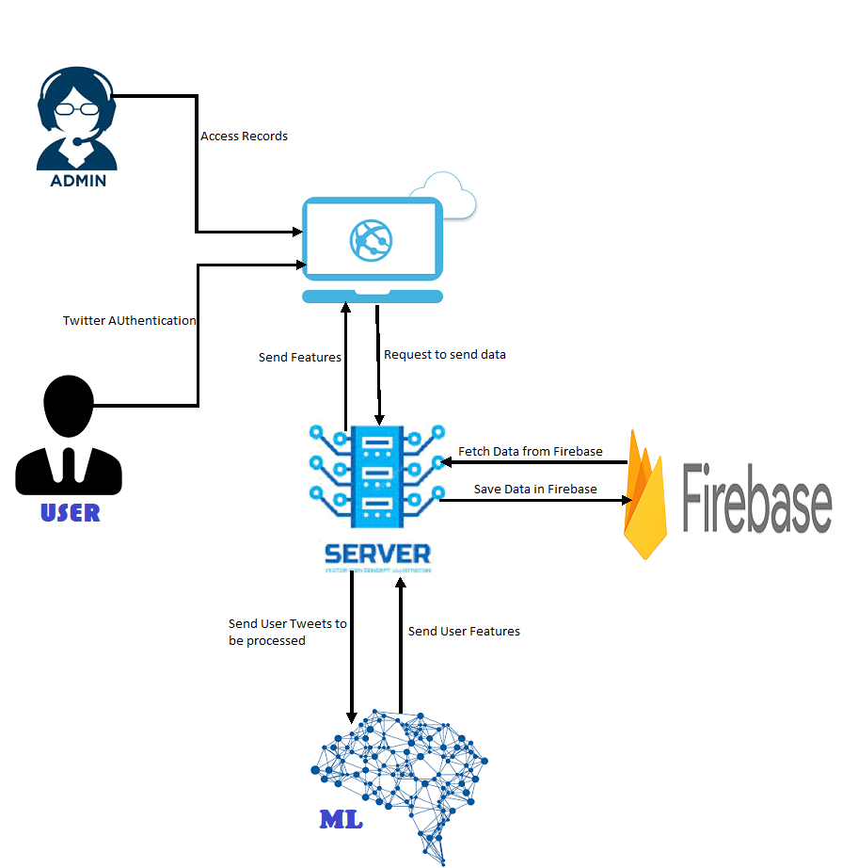
6 – Progress Evaluation

Slide 9
7 – Front End
For front end we have used Angular 8 and Ionic and bootstrap to design our mobile application and Flask for our server side programming.

Slide 10
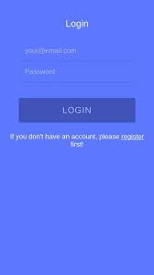
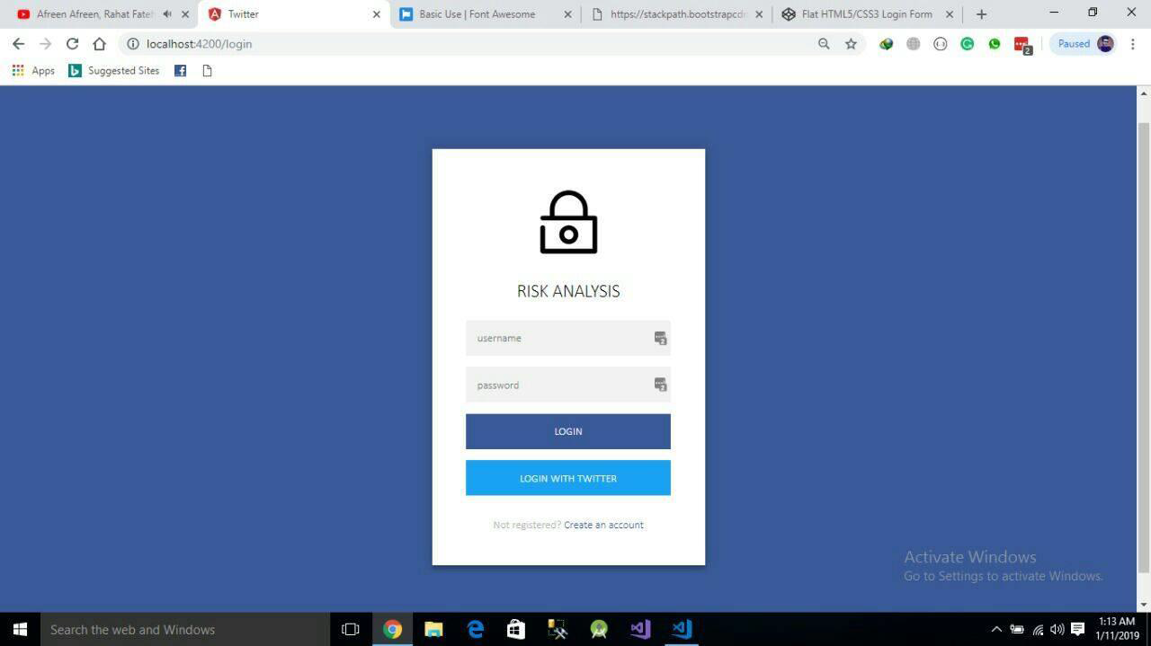
7 – Front End

Slide 11
8 – Database
We have used MongoDB as our No SQL Database.
The idea of using MongoDB was that it provides a fast query scalable database and backend as a service.
The service provides application developers an API that allows application data to be synchronized across clients and stored on MongoDB cloud.

Slide 12
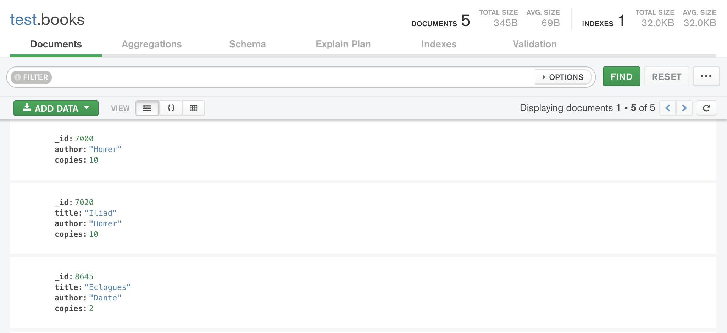
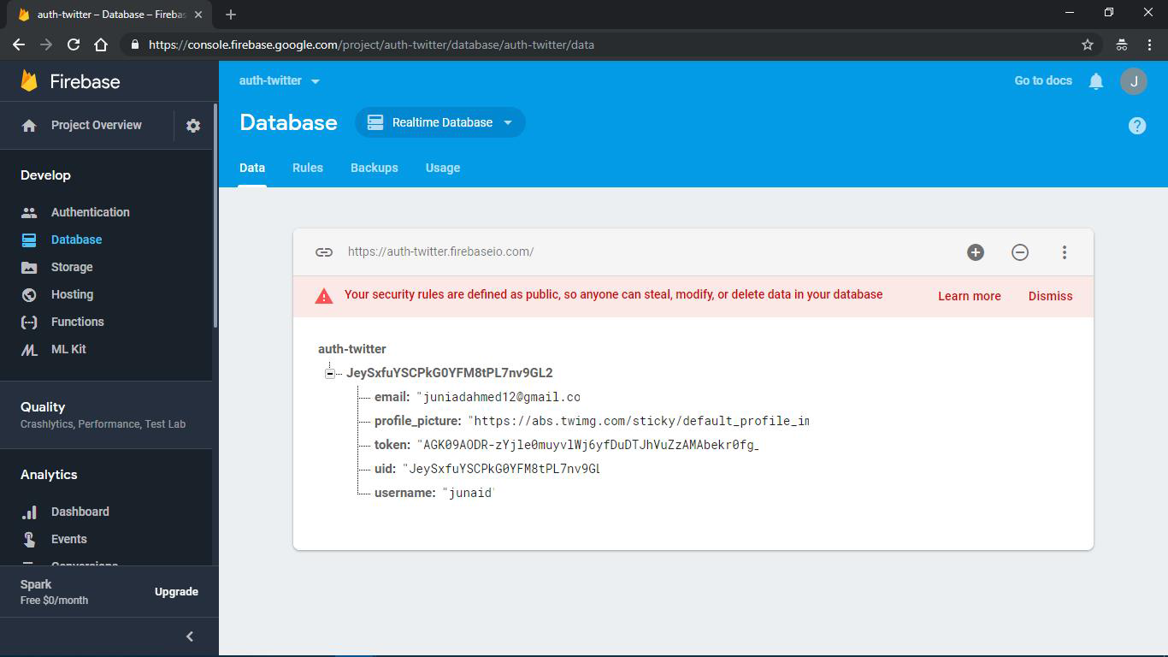
8 – Database

Slide 13
9 – Back End
For Backend we are using Python as our programming language.
For data cleansing and training our model we will use python libraries Scikit, Pandas, Numpy, Keras ,Tensorflow

Slide 14
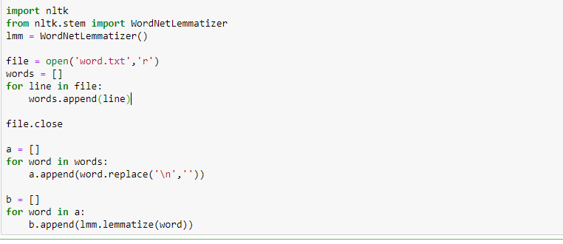
9 – Back End

Slide 15
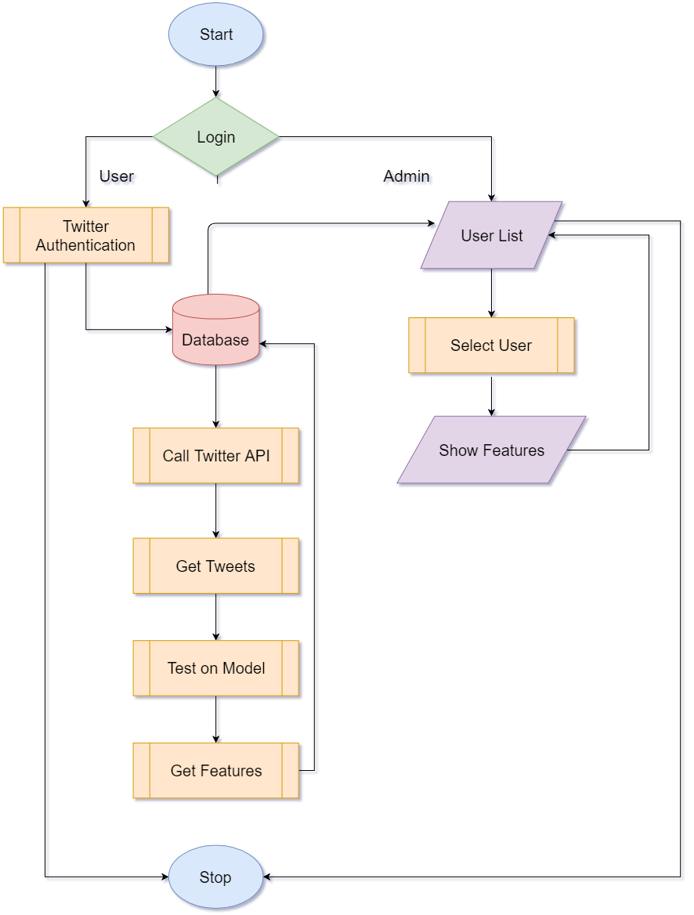
10 – Process Flow Diagram

Slide 16
11 – Final Deliverables
Our own algorithm which detects features of the user. Algorithm created using cognitive + machine learning + deep learning models.
A working web application through which admin can login and see registered users features.
A research paper in which detailed process has been explained which will be submitted with the report.

Slide 17
Thank you!

